Slide 1
FASHION INDUSTRY IMAGE MANAGEMENT
Managing Your Image Inventory has never been easy but now possible!

Slide 2
Elevator pitch
Why we need this solution ?
Photographers work made easy
View, Add, Update and Delete your image shoot with a click of a button.
Company like FOREVERNEW still rely heavily on custom solutions based on stored procedures extracts and products like Akeneo

Slide 3
Concept
Web application to manage image inventory for further application use on website by providing image URL or entire image object.
One Stop to solve the problem of image management by either providing bulk extract or API to directly integrate with.
Function: Multi user, Authentication Based, Add Image, Update existing Image, Delete Image.

Slide 4
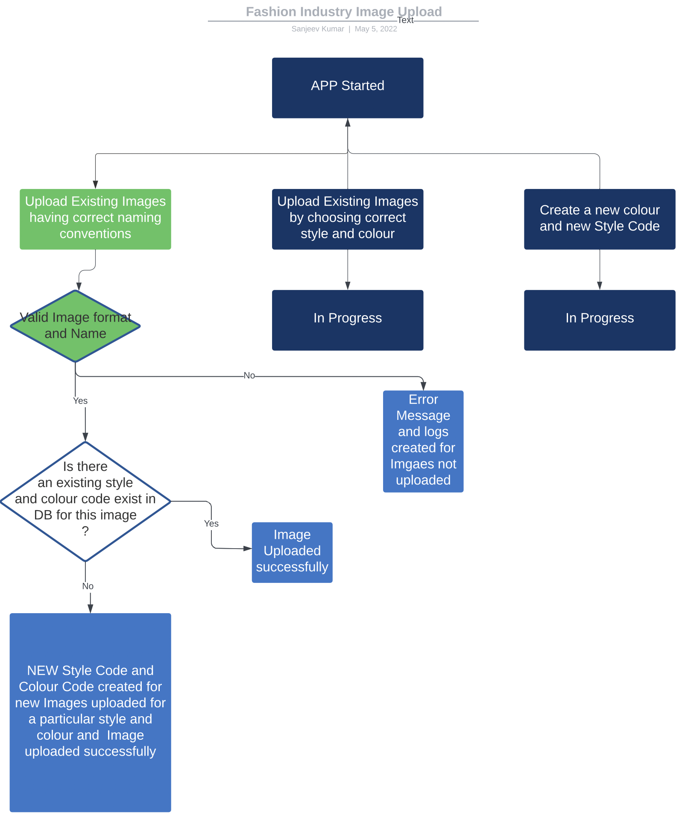
Application Flow and Design

Slide 5
Process
Technologies :GRAPHQL API with NODE.JS and EXPRESS.JS Server and using queries and mutations for retrieving adding updating and deleting image data, REACT, JWT, Authentication, MONGODB, MONGOOSE
TASKS: Business requirement analysis, Application Flow Design, UI design, Coding, Testing
Cloudinary providing APIs and Widget to facilitate but does not provide React based started code. Using React and Javascript in this REACT based project posed some obvious challenges.
Multi user Image management Application deployed successfully in HEROKU environment.

Slide 6
Demo

Slide 7
Directions for Future Development
Making Image upload based upon dropdown selection of Style Colour and Image type
Providing custom UI to insert meta data like style colour and Image type
Providing bulk extract facility for image object in desired formats like CSV, JSON so that websites which do want direct integration can consume these exported files.
Extract facility to only extract images which has changed since last extract. (Full Extract, Delta Extract)

Slide 8
Links
Application : https://fashion-indus-image-management.herokuapp.com/
GitHub Repo : https://github.com/SanjeevKumar-DEV/fashionIndustry-Image-Management

